Slide 1
AUTOMATIC RAIN SENSING MECHANISM
GROUP MEMBERS
AJAY M RAJAN
AKSHAY S
ALLEN ISAAC JOSE
ARJUN K R

Slide 2
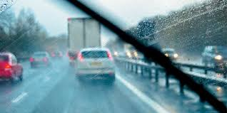
WHY WIPERS…..?
INTRODUCTION

Slide 3
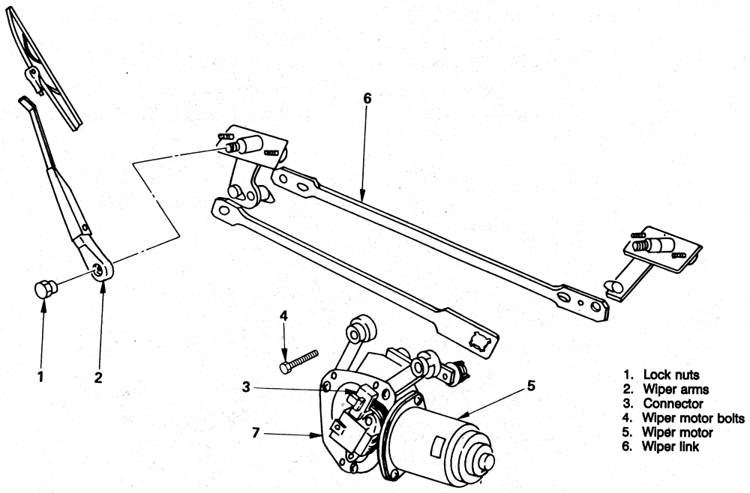

Slide 4
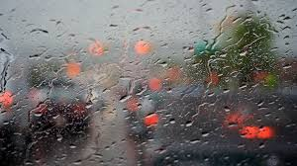
WITHOUT WIPER……….

Slide 5
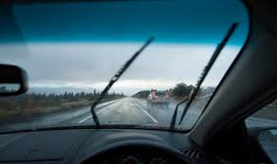
WITH WIPER……….

Slide 6
FASTER MOVING TRAFFIC FOUL WEATHER CONDITIONS IN MOTOR SPEED RACING COMFORT TO PEOPLE(LUXURY COMFORT)
WHY AUTOMATIC WIPER SYSTEM?

Slide 7
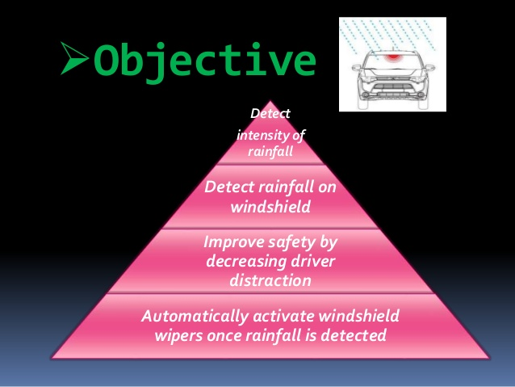

Slide 8
EXISTING MECHANISM

Slide 9
THREE MAIN PARTS 1.WINDSHIELD WIPER MOTOR 2.LINKAGE 3.WORM GEAR
HOW DO WINDSHIELD WIPER WORKS…?

Slide 10
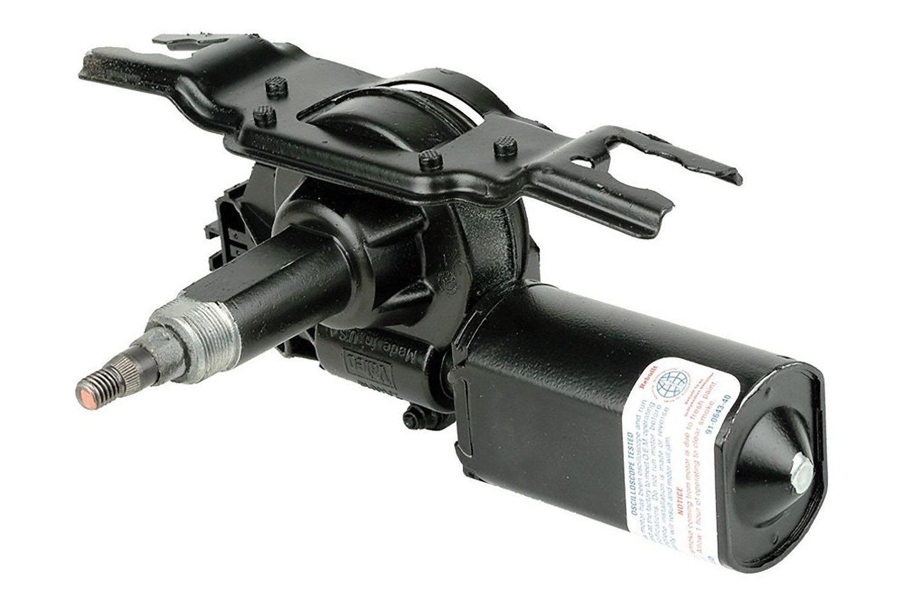
WINDSHIELD WIPER MOTOR

Slide 11
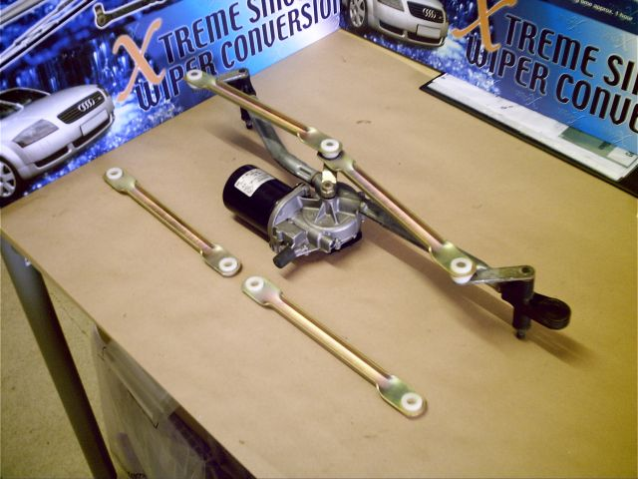
LINKAGE

Slide 12
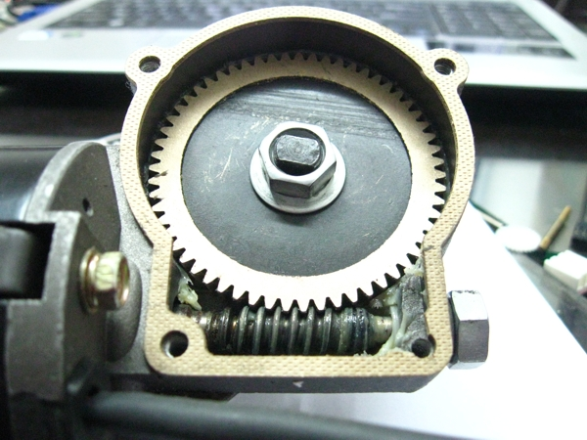
WORM GEAR

Slide 13
1.RUBBER BLADE 2.ARMS 3.SPRING LINKAGE 4.PIVOTS & BRACKETS
VISIBLE PARTS

Slide 14
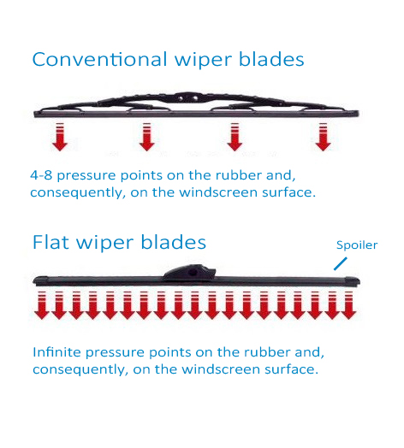
PRESSURE POINTS

Slide 15
PROPOSED DESIGN

Slide 16
Ton = 1.1 R1 C1

Slide 17
OUTPUT WAVEFORM

Slide 18
SENSOR USING CONDUCTING INK

Slide 20
PASTING THE SENSOR MODULE

Slide 21
COMPARISON

Slide 22
Ton = 1.1 R1 C1

Slide 23
ADVANTAGES
COMFORT OF DRIVER
REDUCE POWER CONSUMPTION
USEFUL IN HEAVY TRAFFIC AREAS
CHEAPER THAN EXISTING AUTOMATIC MECHANISM
HANDS-FREE MECHANISM
AUTOMATIC BRAKING

Slide 24
DISADVANTAGE
ABSENCE OF SPEED CONTROL
LACK OF ACCURACY
SYSTEM IS APPLIED ONLY WHEN WATER FALLS ON THE WINDSHIELD

Slide 25
ADVANCED TECHNOLOGY
OPTICAL SENSOR

Slide 27
THANK YOU

